Slide 1


University of Basrah
Al-Zahraa Medical College
Ministry of higher Education and Scientific Research
Academic year 2021-2022
5th year
REPRODUCTIVE BLOCK
Lecture 2
Duration : 1 hour
Abnormal uterine bleeding
Presented by
Dr.RAYA MUSLIM AL HASSAN
Block staff:
Dr.Raya Muslim Al Hassan (Block leader)
Dr.Marwa Sadik (coleader)
Dr. Abdul kareem Hussain Subber
Dr.Alaa Hufdhi
Dr. Luma Zeiny
GYNAECOLOGY 20th
EDITION by Ten Teachers

Slide 2
Objectives:
University of Basrah
Al-Zahraa Medical College
Ministry of higher Education and Scientific Research
Define abnormal uterine bleeding & classical terms applied to its clinical patterns.
Outline the etiology.
Discuss how to evaluate abnormal uterine bleeding.

Slide 3
University of Basrah
Al-Zahraa Medical College
Ministry of higher Education and Scientific Research
Abnormal uterine bleeding: is defined as any alteration in the normal pattern of menstrual flow.
Characteristics of the normal menstrual cycle:
Average length 28 days ( 21-35 days).
Average duration 4 days (1-8 days).
Amount 35 ml (< 80 ml*)

Slide 4
University of Basrah
Al-Zahraa Medical College
Ministry of higher Education and Scientific Research
• HMB: excessive menstrual blood loss (PREVIOUSLY called menorrhagia).
• IMB: bleeding between periods,.
• PCB: bleeding after sex.
• PMB: bleeding more than 1 year after cessation of periods.
• BEO: ‘bleeding of endometrial origin’, a diagnosis of exclusion, has replaced the term ‘dysfunctional uterine bleeding’ (DUB).

Slide 5
Heavy Menstrual Bleeding (HMB)
University of Basrah
Al-Zahraa Medical College
Ministry of higher Education and Scientific Research
Heavy menstrual bleeding (HMB) is now the preferred description & replaces the older term ‘menorrhagia’
For clinical purposes, HMB should be defined as excessive menstrual blood loss which interferes with the woman's physical, emotional, social and the quality of life, and which can occur alone or in combination with other symptoms.
Any interventions should aim to improve quality of life measures rather than focusing on measuring the blood loss.

Slide 6
Aetiology
University of Basrah
Al-Zahraa Medical College
Ministry of higher Education and Scientific Research
Abnormal uterine bleeding classified into :
1)Organic.
2)Non-organic
(BEO).

Slide 7
University of Basrah
Al-Zahraa Medical College
Ministry of higher Education and Scientific Research
NON ORGANIC(BEO):
-no identifiable organic cause ;genital or extragenital.
-it is a dx of exclusion.
-It is classified into ovulatory & anovulatory
a)Ovulatory BEO:
-age 35-45 yr.
-Regular, heavy & often painful menstrual periods.
-Ther may be inadequate progesterone production or
altered life span of corpus luteum.
-occurs in most cases of HMB in which there
may be disordered endometrial prostagladins
production.

Slide 8
University of Basrah
Al-Zahraa Medical College
Ministry of higher Education and Scientific Research
b)Anovulatory BEO ( >85%):
-There is continuous E2 production & endometrial proliferation without corpus luteum formation & progesterone production.
- Commonly occurs at extremes of reproductive age.
In perimenarchal adolescents,it is due to immaturity of
hypothalamo-pituitary ovarian axis.The axis is unable to
respond to E2 with an LH surge.
In perimenopausal women it is due to declining
ovarian function.
-Usually irregular.
- More common in obese women ( peripheral conversion
of ESTrogen to esterone).

Slide 9
Organic causes of Abn.UB
University of Basrah
Al-Zahraa Medical College
Ministry of higher Education and Scientific Research
1) Pregnancy-related:
Miscarriage
Ectopic pregnancy
GTD
PPH
2) Infection :
Cervicitis
Endometritis
PID
3)Endometriosis & adenomyosis.

Slide 10
University of Basrah
Al-Zahraa Medical College
Ministry of higher Education and Scientific Research
4) Neoplasm:
Cervical dysplasia/polyp/ca
Endometrial hyperplasia/ca
Leiomyoma especially submucous
Esterogen-producing ovarian tumor
5) Systemic:
Thyroid disorders (hypo- or hyperthyroidism).
DM
Prolactin disorders
Adrenal disorders
Liver dis.
Renal dis.
Coagulation disorders (vwf deficiency, ITP,lukemia)
Sepsis

Slide 11
University of Basrah
Al-Zahraa Medical College
Ministry of higher Education and Scientific Research
6) Iatrogenic:
Oral contraceptive pills
IUCD
HRT
Steroids
Anticoagulants
7)Trauma & foreign bodies.

Slide 12
Evaluation:
University of Basrah
Al-Zahraa Medical College
Ministry of higher Education and Scientific Research
History: Detailed hx of pattern of menstrual bleeding guides further evaluation:
Regularity,Frequency, duration & amount.
Postcoital or intermenstrual bleeding denotes serious pathology.
Actual blood loss is highly subjective but a rough idea may be gained from:
Number of pads/tampons & frequency of change.
Number of days of flow.
Clots or flooding.
Impact on quality of life.

Slide 13
University of Basrah
Al-Zahraa Medical College
Ministry of higher Education and Scientific Research
Age, parity & marrital status.
Symptoms of pregnancy.
Symptoms of reproductive tract dis.(Dysmenorrhea, dyspareunia, pelvic pain &/or pressure symptoms ).
Abdominal bloating & breast tenderness.
Hx of unusual bleeding from gums, easy bruising & prolonged bleeding after minor cuts.
Wt gain, constipation, fatigue, hair loss & edema.
Galactorrhoea..
Drugs hx.
POHX, PGHX & cervical smear, contraception & sexual hx
PSHS & PMHX :associated comorbidities. GIT or urinary tract bleeding should be ruled out.

Slide 14
EXAMINATION
University of Basrah
Al-Zahraa Medical College
Ministry of higher Education and Scientific Research
Vital signs.
Height & weight.
Tanner’ s staging of breast, axillary & pubic hair.
Ecchymoses & petechiae.
Hirsutism, skin pigmentation, striae, thyroid enlargement or nodularity.
Abdominal palpation for liver enlargement, pelvic masses & regional lymphadenopathy.
PR if GIT bleeding is suspected.

Slide 15
Pelvic examination:
University of Basrah
Al-Zahraa Medical College
Ministry of higher Education and Scientific Research
A physical examination should be carried out before :
LNG-IUS fittings.
investigations for structural abnormalities
investigations for histological abnormalities.
Vulval inspection & speculum examination of vagina & cervix, if appropriate, for external evidence of bleeding, foreign body, trauma or signs of local disease e.g. vaginal atrophy, cerrvical erosion, polyp or ca.
Vaginal/cervical swabs & pap smear if clinically indicated.
Bimanual examination to assess uterine size, symmetry, adenexal mass & tenderness if appropriate.

Slide 16
LAB. Tests:
Patient’s HX & EX guide selection of various tests.
University of Basrah
Al-Zahraa Medical College
Ministry of higher Education and Scientific Research
Β-HCG if any possibility of pregnancy exists.
Full blood count should be carried out on all women with HMB.
A serum ferritin test should NOT routinely be carried out on women with HMB
Coagulation profile: (e.g, von Willebrand disease) should be considered in women who have had HMB since menarche & have personal or family history suggesting a coagulation disorder.
TFT: only if other signs & symptoms of thyroid disease are present
Female hormone testing (prolactin, FSH, LH, E2 & mid-luteal progesterones) should NOT be carried out on women with HMB.
Serum androgens (testosterone, DHEA-S, SHBG, androstendione) if there are signs of hyperandrogenism.
LFT & RFT in systemic dis or malignancy.

Slide 17
Structural & histological IXs
Indication of Imaging
University of Basrah
Al-Zahraa Medical College
Ministry of higher Education and Scientific Research
should be undertaken in the following circumstances:
The uterus is palpable abdominally.
Vaginal examination reveals a pelvic mass of uncertain origin.
Medical treatment fails.

Slide 18
University of Basrah
Al-Zahraa Medical College
Ministry of higher Education and Scientific Research
Imaging:
Ultrasound: is the first-line diagnostic tool for identifying structural abnormalities (measures endometrial thickness & diagnoses polyps, leiomyomata, areas of adenomyosis & polycystic ovaries). Colour flow Doppler provides information about pelvic vascularity
Saline infusion sonography (SIS): should not be used as a first-line diagnostic tool
CT/ MRI: should not be used as a first-line diagnostic tool, more invasive, used when better delineation of pelvic structures is needed.

Slide 19
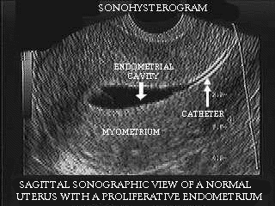
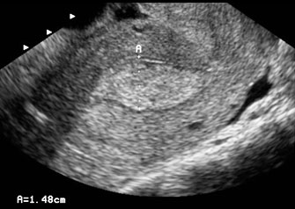
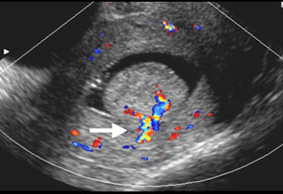
TVS & SIS
TVS
SIS

Slide 20
University of Basrah
Al-Zahraa Medical College
Ministry of higher Education and Scientific Research
Endometrial sampling:
If appropriate, a biopsy should be taken to exclude endometrial cancer or atypical hyperplasia.
Indications for a biopsy include
irregular bleeding or persistent intermenstrual bleeding
women aged 45 & over
treatment failure

Slide 21
University of Basrah
Al-Zahraa Medical College
Ministry of higher Education and Scientific Research
Methods of endometrial sampling:
1. Aspiration techniques (Pipelle): rapid outpatient screening test with limited sensitivity.
•2.Dilatation & curettage (D&C):in this traditional blind procedure only about 50% of endometrium is sampled.

Slide 22
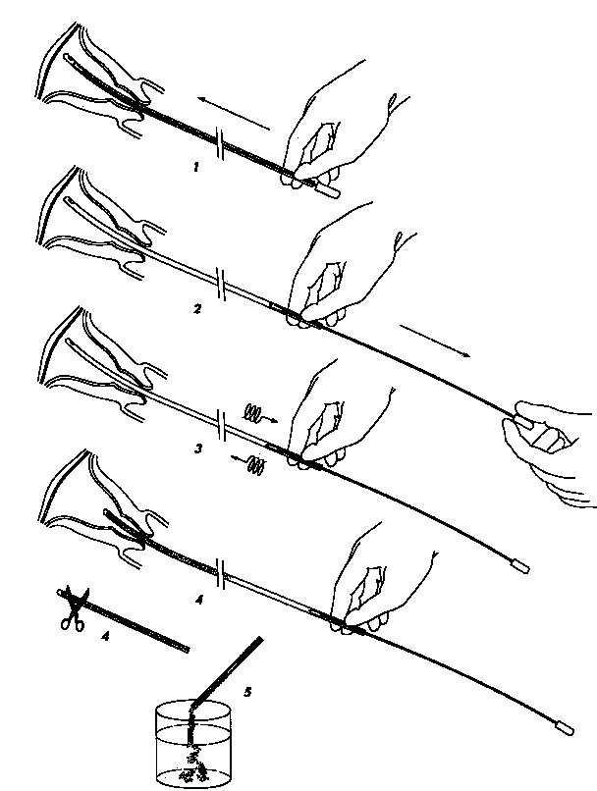
Endometrial Biopsy (EMB)
University of Basrah
Al-Zahraa Medical College
Ministry of higher Education and Scientific Research
Evaluation of the Endometrium
  Pipelle
Notes:
Endometrial Biopsy is sensitive 98-99% in diagnosing cancer, but it misses 50% of benign diagnosis (i.e., polyps, fibroids, endometritis).

Slide 23
University of Basrah
Al-Zahraa Medical College
Ministry of higher Education and Scientific Research
3. Hysteroscopy: is the gold standard procedure as it provides visualization of entire endometrial cavity& allows specifically-directed biopsy. It is ideally performed in the proliferative phase where endometrium is at its thinnest.

Slide 25
TREATMENT
University of Basrah
Al-Zahraa Medical College
Ministry of higher Education and Scientific Research
1.Medical;
Hormonal:mirena pills
Non hormonal:
NSAID
Antifibrinolytic
2.Surgical
according to the cause

Slide 26
Readings
University of Basrah
Al-Zahraa Medical College
Ministry of higher Education and Scientific Research
1. Gynaecology by Ten Teachers, 20th Edition
Ash Monga, Stephen Dobbs
2. Nice guidance 44, heavy menstrual bleeding

